Slide 1
Module 2: Network Architecture & Wireless Basics (Week 2)
Building Network and Wireless Understanding

Slide 2
Objectives
OSI model layers and their functions (simplified for AI applications)
TCP/IP protocol suite basics and network addressing
Core network vs. access network concepts
Radio frequency spectrum and propagation principles
Cellular network concepts and evolution from 1G to 5G

Slide 3
Introduction to OSI Model
Defines 7 layers for interoperability in networks.

Slide 4
Application Layer
The Application Layer is the topmost layer of the OSI model. It is where end-user applications and software interact with the network. Unlike lower layers, it doesn’t handle “how” data is sent; it focuses on what the data is and how it’s presented to applications.

Slide 5
Application Layer
Interface for Applications: Provides a way for software to request network services (e.g., sending a request to a server or receiving data).
High-Level Protocols: Implements protocols like HTTP, FTP, SMTP, DNS, or gRPC, which applications use to communicate.
Data Representation and Formatting: Ensures data is in a format that the receiving application can understand (e.g., JSON, XML, protobuf).
Resource Access: Enables access to remote resources like APIs, cloud storage, databases, or other AI services.

Slide 6
Transport Layer
Reliable communication via TCP, fast datagrams via UDP.

Slide 7
Network Layer
IP addressing and routing packets across networks.
The Network Layer is responsible for moving data packets from a source device to a destination device across multiple networks. It ensures that data can travel even if the devices are not on the same local network.

Slide 8
Data Link & Physical Layers
Error control and physical transmission via RF/cables.
The Physical Layer deals with the actual transmission of raw bits (0s and 1s) over a physical medium—cables, fiber optics, Wi-Fi, or radio waves.

Slide 9
Data Link & Physical Layers
Converts digital data into electrical, optical, or radio signals.
Handles the hardware aspects: connectors, cables, switches, NICs.
Defines transmission speed, voltage levels, and signal timing.

Slide 10
Diagram: OSI Model
Application
Transport
Network
Data Link
Physical

Slide 11
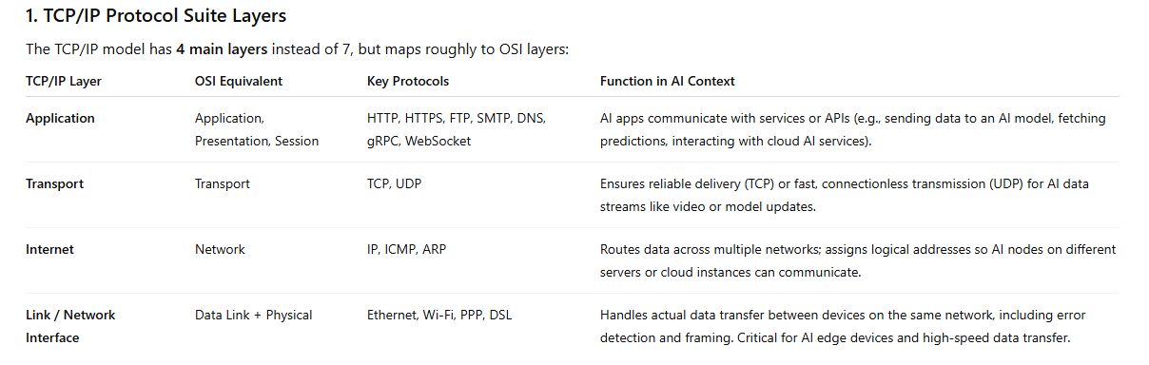
Introduction to TCP/IP
Practical protocol suite for Internet.

Slide 12
Application Layer
Covers HTTP, FTP, SMTP, AI APIs.
The Application Layer is the topmost layer of TCP/IP. It provides the interface through which applications interact with the network. It doesn’t concern itself with how data gets delivered; instead, it focuses on what the application wants to send or receive.

Slide 13
Application Layer
Application Services: Supports services like web browsing, email, file transfer, and APIs.
Data Representation: Converts data into formats suitable for communication (JSON, XML, images, or protobuf).
Communication Protocols: Implements high-level protocols that applications use to exchange data.
Resource Access: Enables access to remote resources like cloud servers, AI models, or databases.

Slide 14
Transport Layer
TCP ensures reliability, UDP ensures speed.
The Transport Layer is responsible for reliable delivery of data between applications on different devices. It ensures that the data sent from one program reaches the correct program on the receiving device, intact and in order.

Slide 15
Transport Layer
Segmentation & Reassembly: Splits large data into smaller chunks (segments) and reassembles them at the destination.
End-to-End Communication: Connects applications on source and destination machines.
Error Detection & Recovery: Ensures data is received correctly; retransmits lost or corrupted segments.
Flow Control: Regulates the rate of data transmission to prevent congestion.
Multiplexing: Allows multiple applications to share a single network connection.

Slide 16
Internet Layer
IP addressing, routing, ICMP.
The Internet Layer is responsible for routing and delivering data packets across networks. It ensures that data sent from a source device can reach the correct destination device, even if they are on different networks.

Slide 17
Internet Layer
Logical Addressing: Assigns IP addresses (IPv4/IPv6) to devices so packets know where to go.
Routing: Determines the best path for data to travel from source to destination across multiple networks.
Packet Forwarding: Moves packets from one network segment to another through routers.
Fragmentation & Reassembly: Splits large packets for transmission across networks and reassembles them at the destination.
Error Handling: Basic network-level error notifications via protocols like ICMP.

Slide 18
Network Access Layer
Ethernet, Wi-Fi, LTE, 5G physical links.
The Network Access Layer is responsible for sending data over the physical network medium and ensuring it reaches the next device in the network. It handles hardware addressing, error detection, and actual transmission.

Slide 19
Network Access Layer
Framing: Packages data from the Internet Layer into frames for transmission.
Physical Addressing: Uses MAC addresses to identify devices on the same local network.
Error Detection & Correction: Checks for errors in transmitted frames and requests retransmission if needed.
Access Control: Manages which device can use the network at a given time (important in shared media like Wi-Fi).
Physical Transmission: Converts frames into electrical, optical, or radio signals for the medium (cables, fiber, Wi-Fi).

Slide 20
Diagram: TCP/IP Stack
Application
Transport
Internet
Network Access

Slide 21
Access Network
Connects end-users via Wi-Fi, LTE, 5G.
An Access Network is the segment of a network that links end users or devices to the core network (backbone network). It determines how devices physically or wirelessly connect to the network.

Slide 22
Access Network
Device Connectivity: Ensures end devices can access the network.
Bandwidth Management: Provides enough speed for devices to transmit data (critical for AI data-heavy applications).
Authentication & Security: Ensures only authorized devices connect to the network.
Data Transmission: Delivers data frames/packets from devices to the next network segment or the Internet.

Slide 23
Core Network
Backbone of high-capacity routers and switches.
The Core Network is the central part of a network that connects multiple access networks together. It acts as the backbone that routes data between different parts of a network and to external networks like the Internet.

Slide 24
Interaction
Access → Core → Internet/AI services.

Slide 25
AI Applications
Core handles large AI data, Access connects IoT devices.

Slide 26
Diagram: Core vs Access
Internet / Cloud
Access Network
Core Network

Slide 27
RF Spectrum
Wireless communication uses licensed/unlicensed bands.

Slide 28
Free-space Path Loss
Signal power decreases with distance.

Slide 29
Attenuation
Walls, trees, rain reduce signal strength.

Slide 30
Multipath/Fading
Reflections cause interference at receiver.

Slide 31
Applications in AI
Used in IoT, drones, autonomous vehicles.

Slide 32
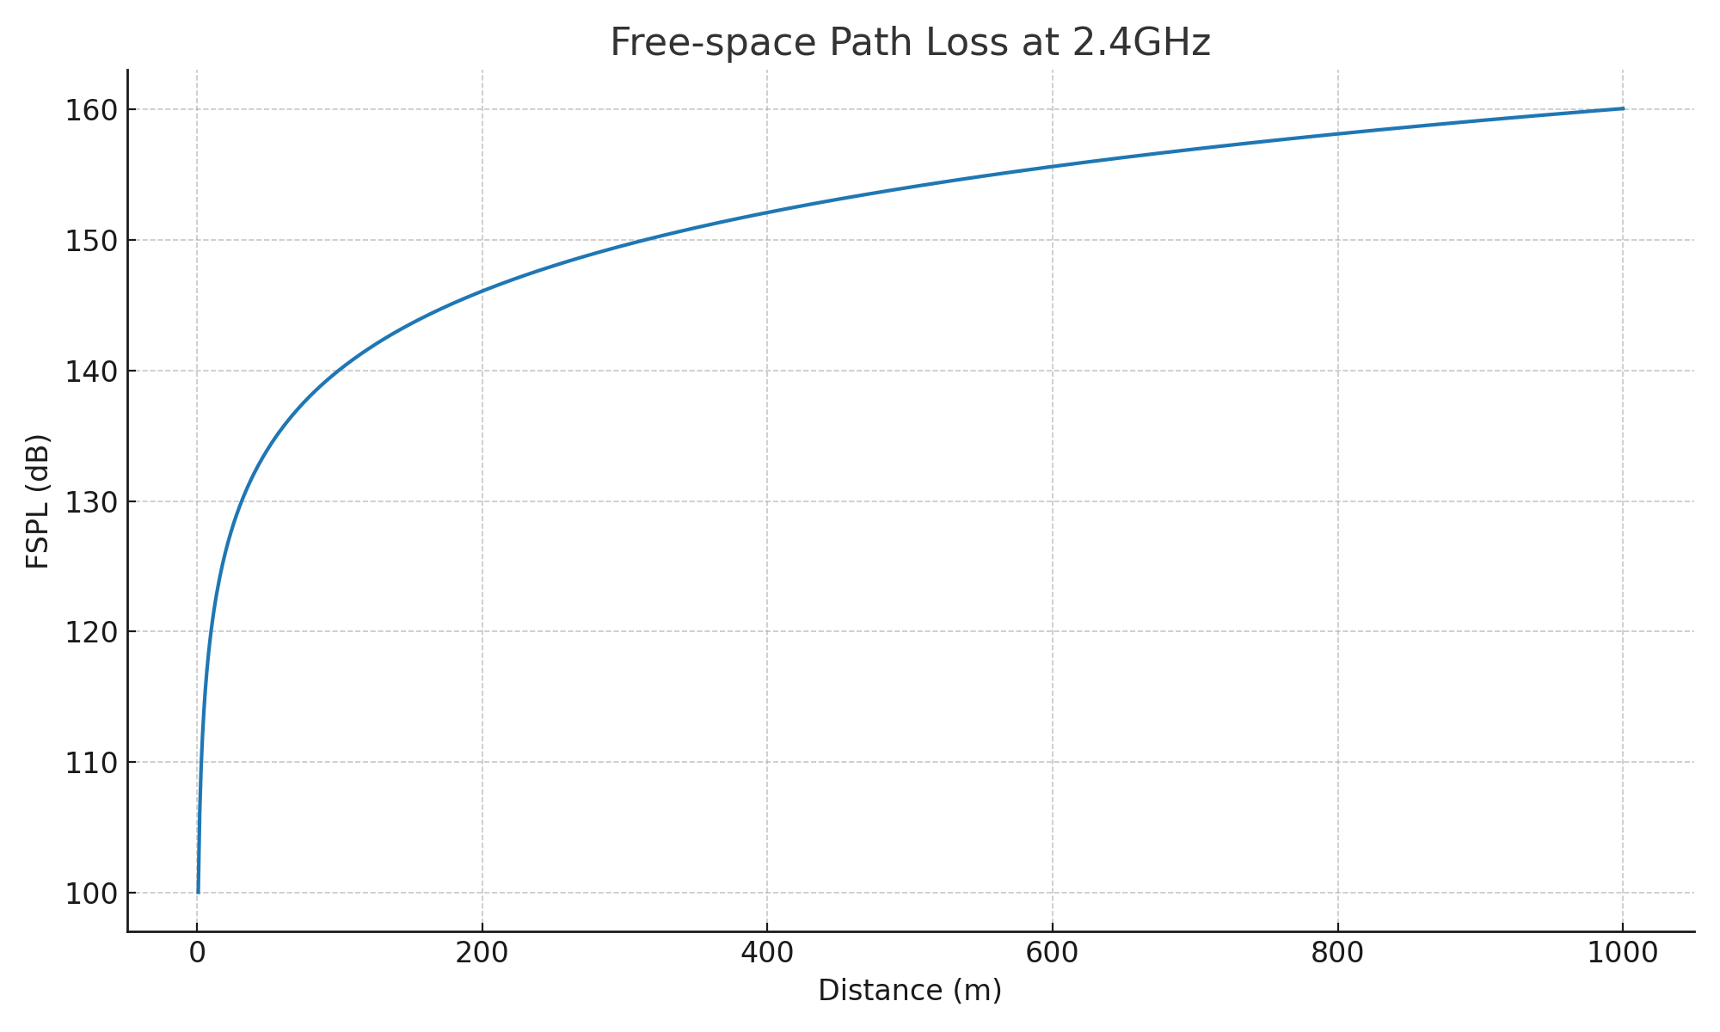
Diagram: RF Propagation

Slide 33
1G: Analog
Voice only, launched 1980s.

Slide 34
2G: Digital
Voice & SMS, introduced SIM cards.

Slide 35
3G: Internet
Enabled mobile web and video calls.

Slide 36
4G: Broadband
High-speed data, HD streaming.

Slide 37
5G: AI & IoT
Ultra-low latency, IoT, automation.

Slide 38
Diagram: Cellular Evolution
1G
2G
3G
4G
5G

Slide 39
Wireshark Overview
Free tool for packet capture and protocol analysis.

Slide 40
Capturing Packets
Monitor real-time data flows on a network interface.

Slide 41
Analyzing TCP/IP
Inspect headers, source/destination IPs, ports.

Slide 42
RF Modeling in Python
Use FSPL formula to simulate RF strength.

Slide 43
Visualizing RF
Graphs showing signal loss vs distance.

Slide 44
Applications in AI
AI-based monitoring & optimization of networks.

Slide 45
Links
https://www.youtube.com/watch?v=vv4y_uOneC0&pp=ygVFT1NJIG1vZGVsIGxheWVycyBhbmQgdGhlaXIgZnVuY3Rpb25zIChzaW1wbGlmaWVkIGZvciBBSSBhcHBsaWNhdGlvbnMp
https://www.youtube.com/watch?v=Ilk7UXzV_Qc&pp=ygVFT1NJIG1vZGVsIGxheWVycyBhbmQgdGhlaXIgZnVuY3Rpb25zIChzaW1wbGlmaWVkIGZvciBBSSBhcHBsaWNhdGlvbnMp0gcJCbIJAYcqIYzv
https://www.youtube.com/watch?v=Ca1jnqwqzg0&pp=ygVFT1NJIG1vZGVsIGxheWVycyBhbmQgdGhlaXIgZnVuY3Rpb25zIChzaW1wbGlmaWVkIGZvciBBSSBhcHBsaWNhdGlvbnMp

